Slide 1
Network Models

Slide 2
Network Models
Topology describes how parts of a whole work together
Physical topology mostly refers to a network’s hardware and how computers, other devices, and cables work together to form the physical network
Logical topology refers to how software controls access to network resources
It includes how users and software initially gain access to the network
A network operating system (NOS) controls access to the entire network
A NOS is required by client-server models

Slide 3
Peer-to-Peer Network Model (1 of 2)
In a peer-to-peer (P2P) network model the OS of each computer on the network is responsible for controlling access to its resources
There is no centralised control
Computers, called nodes or hosts, form a logical group of computers and users
Each computer controls its own administration, resources, and security
Advantages
Simple configuration
Less expensive compared to other network models
Disadvantages
Not scalable
Not necessarily secure
Not practical for large installations

Slide 4
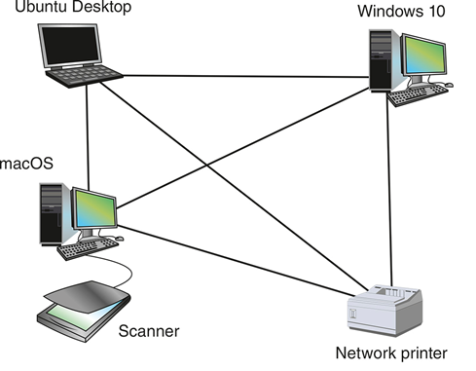
Peer-to-Peer Network Model (2 of 2)
Figure 1-1 In a peer-to-peer network, no computer has more authority than another; each computer controls its own resources and communicates directly with other computers​

Slide 5
Client-Server Network Model (1 of 3)
Resources are managed by the NOS via a centralised directory database
A Windows domain is a logical group of computers that a Windows Server can control

Slide 6
Client-Server Network Model (1 of 3)
Active Directory (AD) is the centralised directory database that contains user account information and security for the entire group of computers
A user can sign on to the network from any computer on the network and gain access to the resources that AD allows
This process is managed by Active Directory Domain Services (AD DS)
A computer making a request from another is called the client

Slide 7
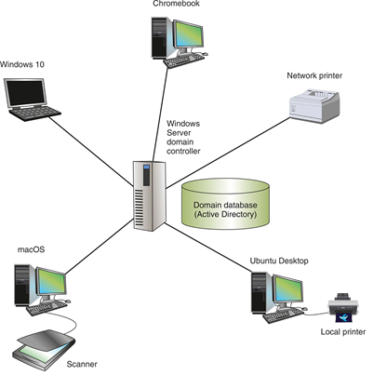
Client-Server Network Model (2 of 3)
Figure 1-2 A Windows domain uses the client-server model to control access to the network, where security on each computer or device is controlled by a centralised database on a domain controller

Slide 8
Client-Server Network Model (3 of 3)
The NOS is responsible for:
Managing client data and other resources
Ensuring authorised user access
Controlling user file access
Restricting user network access
Dictating computer communication rules
Supplying applications and data files to clients
Servers that have a NOS installed require:
More memory, processing power, and storage capacity
Equipped with special hardware to provide network management functions

Slide 9
Client-Server Applications (1 of 2)
Network services are the resources a network makes available to its users
It includes applications and the data provided by these applications
In client-server applications:
A client computer requests data or a service from a second computer, called the server

Slide 10
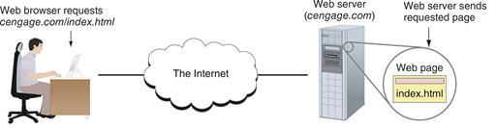
Client-Server Applications (2 of 2)
Figure 1-3 A web browser (client application) requests a web page from a web server (server application); the web server returns the requested data to the client

Slide 11
Network Services and Their Protocols (1 of 2)
Protocols are methods and rules for communication between networked devices
Two primary network protocols:
TCP (Transmission Control Protocol)
IP (Internet Protocol)
Popular client-server applications include:
Web service
Email services
DNS service
FTP service
Database services
Remote access service

Slide 12
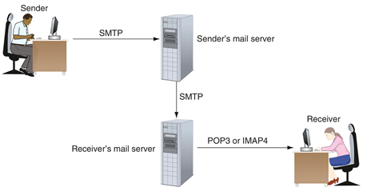
Network Services and Their Protocols (2 of 2)
Figure 1-5 SMTP is used to send email to a recipient’s email server, and POP3 or IMAP4 is used by the client to receive email

